Slide 1
PERSONAL LOAN STATS AND INSIGHTS

Slide 2
INTRODUCTION
It is a loan taken by individuals from a bank or a non-banking financial company (NBFC) to meet their personal needs.
Personal loan is an EDA Research and this type of data are used to analysis.

Slide 3
 | ID | Application Date | CITY | INCOME | STAGE
0 | 1 | 30-Sep-18 | North West Delhi | 307296 | Stage 1
1 | 2 | 30-Sep-18 | North West Delhi | 323976 | Stage 0
2 | 3 | 30-Sep-18 | Mumbai | 235632 | Stage 1
3 | 4 | 30-Sep-18 | Jaipur | 250668 | Stage 0
4 | 5 | 30-Sep-18 | Lakhimpur | 533616 | Stage 0

Slide 4
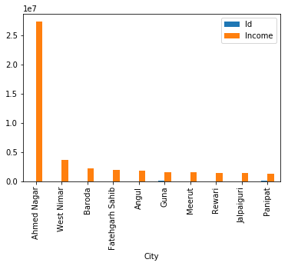
THE TOP 10 CITY WITH HIGHER INCOME.

Slide 6
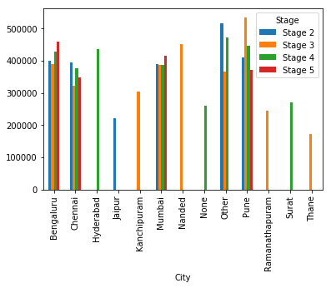
PIVOT_TABLE pd.pivot_table(data[(data.Stage != 'Stage 0') & (data.Stage != 'Stage 1')], values= 'Income', index = 'City', columns= 'Stage', aggfunc= 'mean', fill_value= 0).plot(kind = 'bar')

Slide 7
TOP 5 CITY BASED ON THE NUMBER OF TIMES OCCURRED
 | CITY | TOP 5
0 | Bengaluru | 3594
1 | Mumbai | 1113
2 | Chennai | 1109
3 | Pune | 911
4 | Thane | 301

